Slide 1
AIRLINE COMPANY DATABASE
DAMG 6210 – Data Management and Database Design
Presented By- Krupali Tejani (002305966)

Slide 2
Table of contents
01
02
03
Problem Statement
Users and Functionalities
Use Case Diagram
04
05
06
ER Diagram
Normalization Steps
Project

Slide 3
Project Summary
The Airline Database helps an airline efficiently manage flights, reservations, and crewschedules.
This database provides up-to-date information on flights, seat availability, and booking status, improving service for passengers and simplifying day-to-day operations for the airline.
The database serves several user groups. Passengers can search for flights, book tickets, check their booking details, and receive notifications.
Airline Staff, such as booking agents, use it to manage reservations, handle cancellations, and assist passengers.
The Operations Team uses the database to organize crew schedules and assign crew to flights.
Airline Administrators can also generate reports, monitor popular routes, and adjust prices based on demand trends.

Slide 4
Users and Functionalities
Passengers
Operations Team
Crew Members
-Search Flights
-Book Flight Tickets
-Cancel/Modify Bookings
-Check Flight Status
-View Booking History
-Flight schedules
-Track aircraft availability
-Manage route planning
-Manage crew
-Assignments
-Update Flight Status
-Access Flight Schedule
-Check Crew work Schedule
-Request Schedule Changes
-Log Work Hours
Airline Staff
Travel Agencies
Airline Administration
-Manage passenger reservations
-Assign seats
-Update passenger details
-View crew details
-Handle customer inquiries
-Manage Passenger Accounts
-Create Travel Package
-View Flight Details
-Search Available Flights
-Issue Ticket
-Manage Reservation
-Manage Employee Records
-Revenue Management
-Booking creation, modification, and cancellation
-Complaint and feedback management
-Aircraft maintenance scheduling

Slide 5
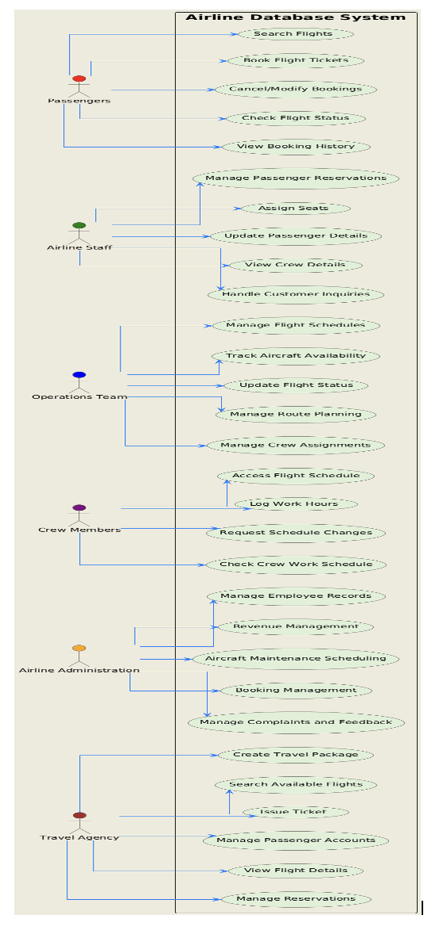
Use Case Diagram

Slide 6
Passengers (1) → (M) Reservations Flights (1) → (M) Reservations Flights (1) → (M) CrewMembers Airports (1) → (M) Flights Airports (1) → (M) Staff Reservations (1) → (M) Tickets Tickets (M) → (1) Reservations Passengers (1) → (M) Tickets Payments (1) → (1) Reservations Aircraft (M) → (1) Airports
Entities-
1. Passengers
2. Flights
3. Airports
4. Aircrafts
5. Reservations
6. Tickets
7. Payments
8. CrewMembers
9. WorkSchedules
10. Staff
11. Routes
12. TravelAgencies
13. AgencyReservations
Relationships-
Aircraft (1) → (M) Flights Aircraft (1) → (M) Maintenance CrewMembers (1) → (M) WorkSchedules CrewMembers (M) → (1) Flights WorkSchedules (M) → (1) Flights Staff (M) → (1) Airports TravelAgencies (1) → (M) Reservations TravelAgencies (1)→(M) AgencyReservations Routes (1) → (M) Flights

Slide 7
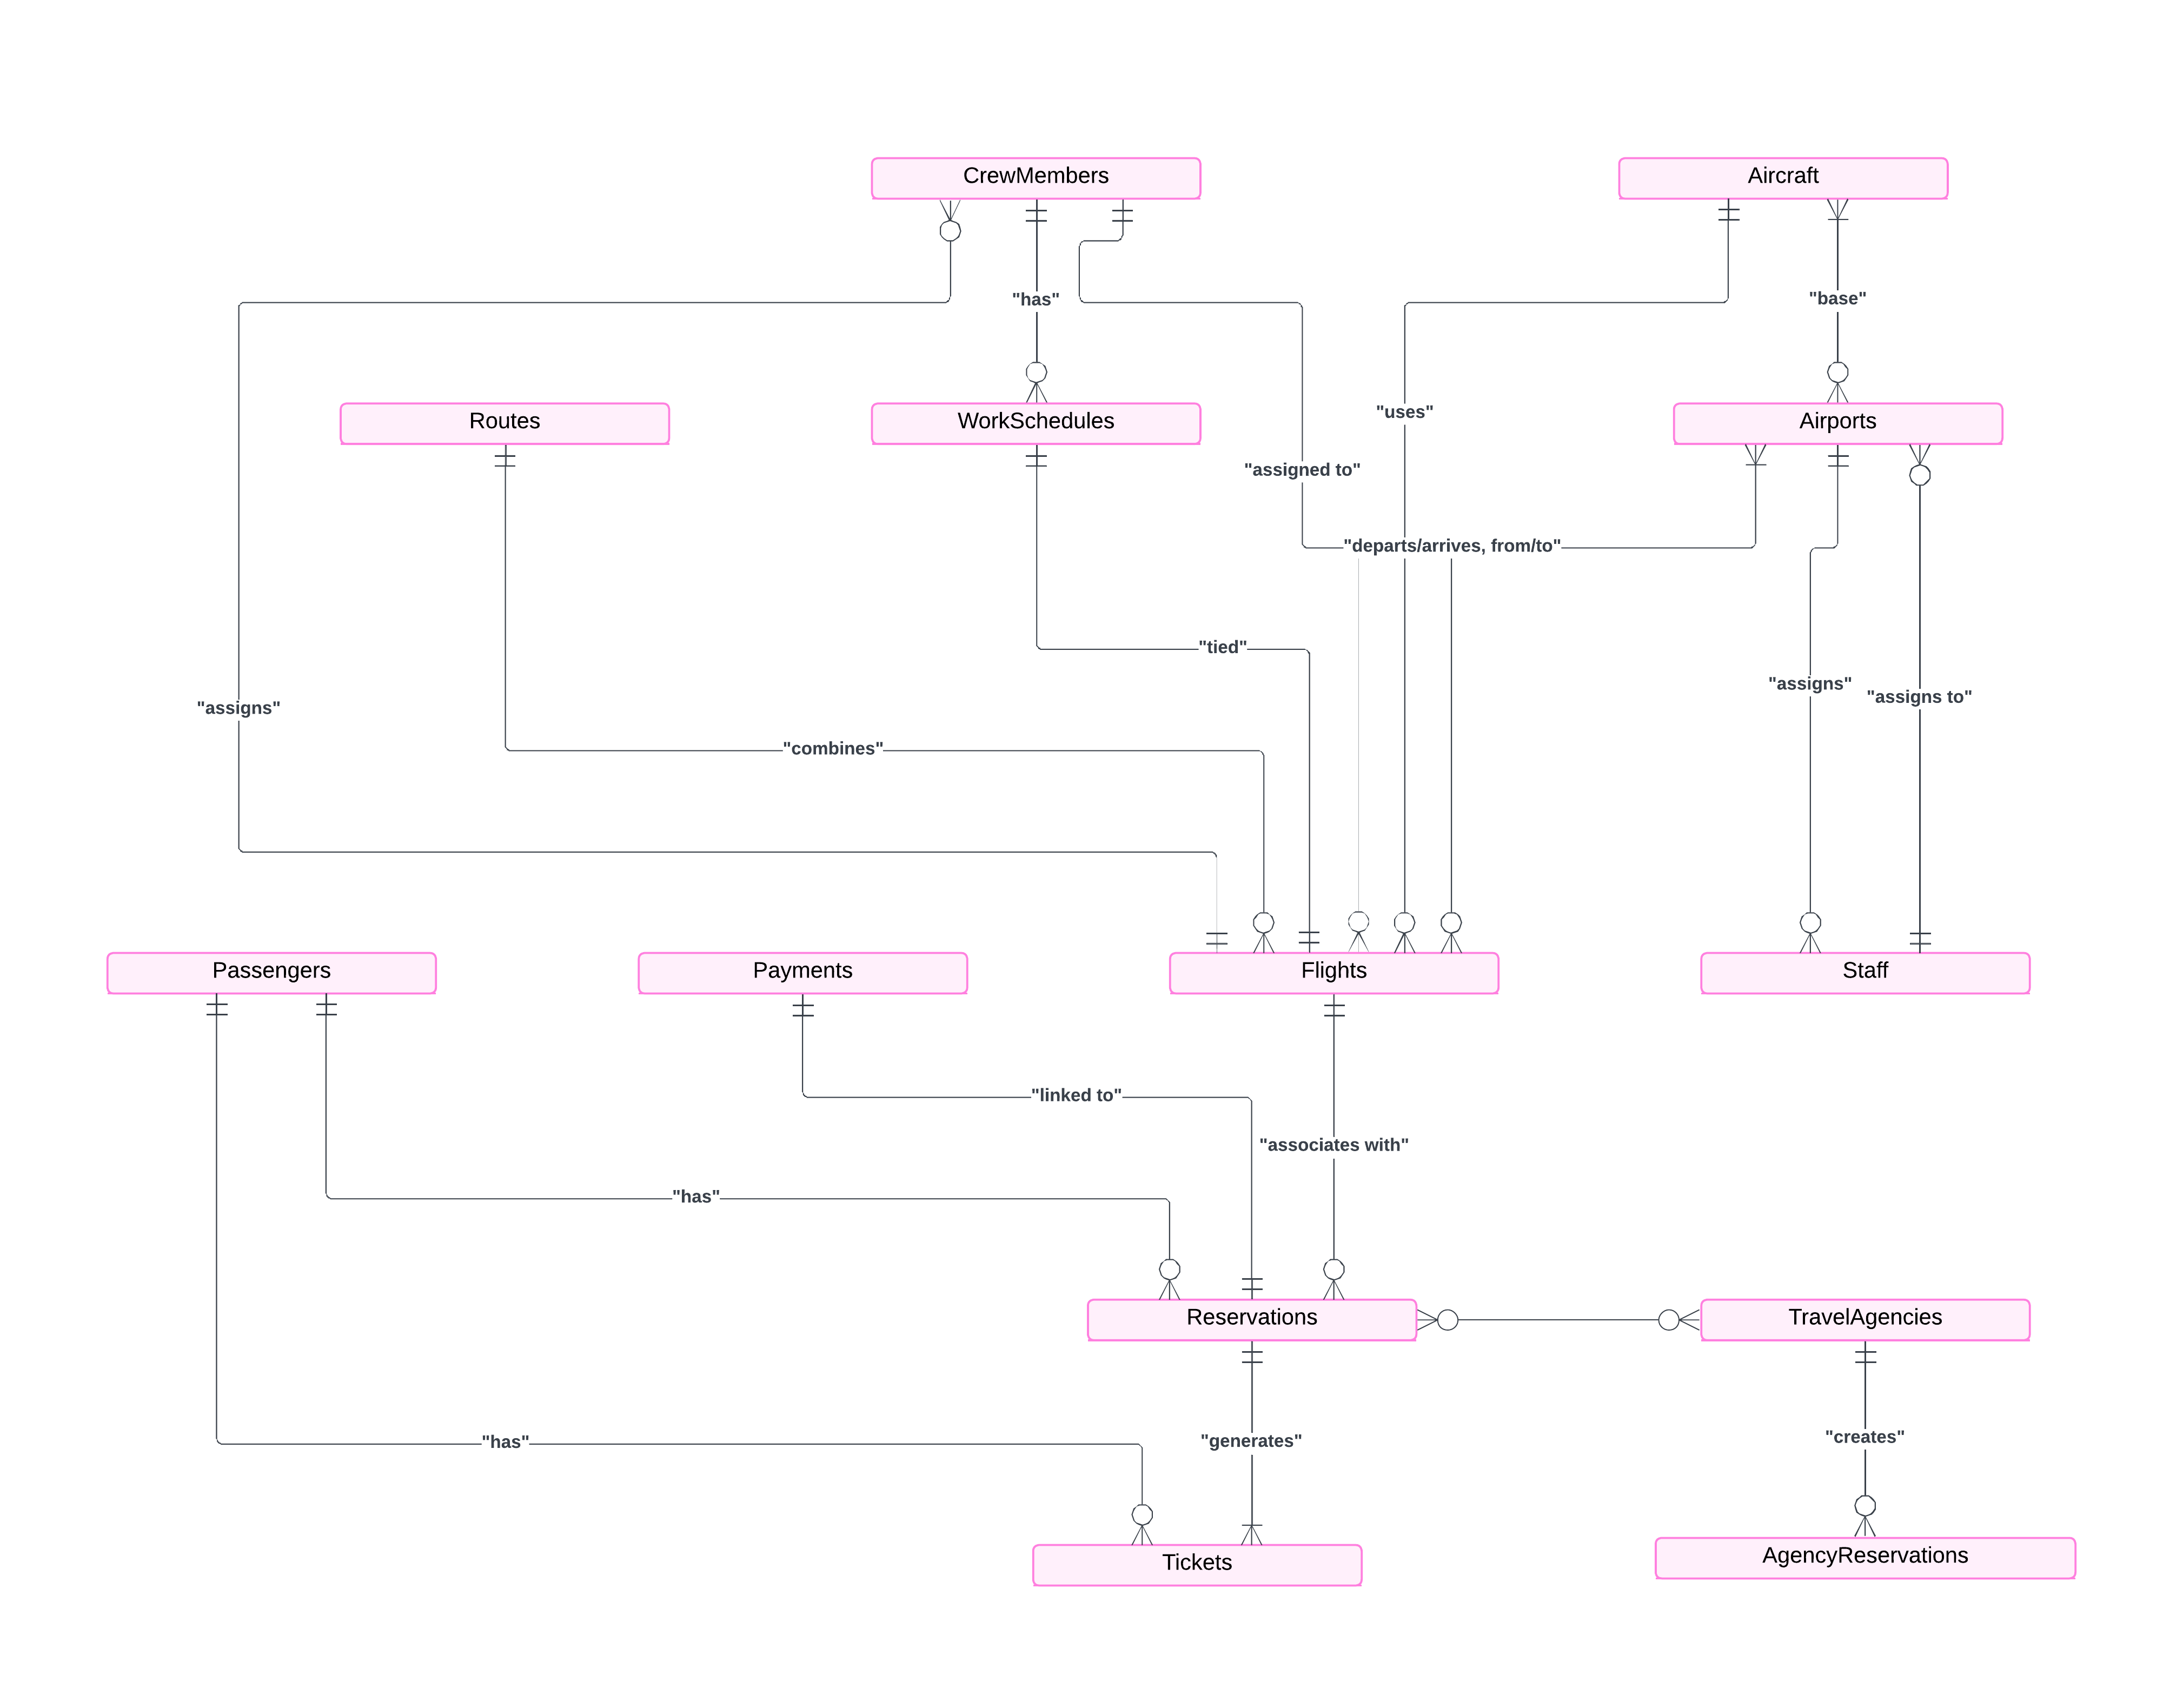
E R Diagram

Slide 8
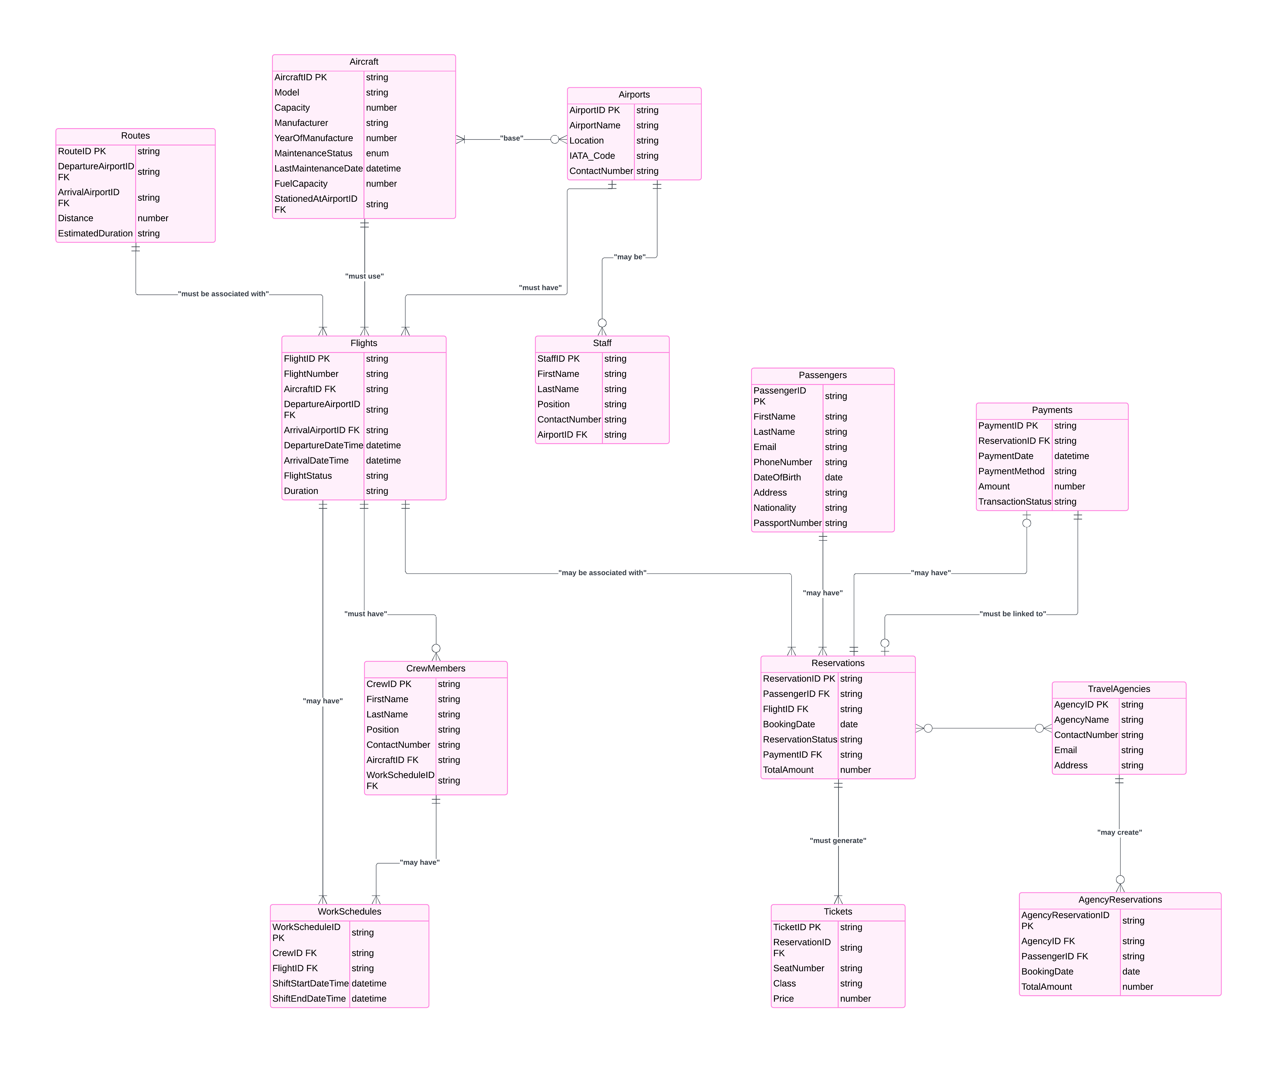

Slide 9
Normalization Steps
First Normal Form (1NF):
In the schema, all the attributes like Phone, Email, etc., are atomic, and each table meets 1NF.
Second Normal Form (2NF):
Non-key attributes are fully functionally dependent on the primary key.
For instance, in Flights, FlightStatus, GateNumber, and WeatherConditions depend only on FlightID,
Third Normal Form (3NF):
No transitive dependencies
The ReservationID uniquely identifies each reservation, and the foreign keys (PassengerID, FlightID, PaymentID, BookingAgencyID) reference unique records in their respective tables, with no partial or transitive dependencies.
Boyce-Codd Normal Form:
It must meet the 3NF requirements, and for every functional dependency, the left-hand side must be a superkey.
Fourth Normal Form(4NF):
In the Aircraft table, attributes such as MaintenanceStatus and LastMaintenanceDate depend directly on AircraftID.There are no multivalued dependencies here. An aircraft can have only one set of maintenance details at a time. 4NF satisfied.

Slide 10
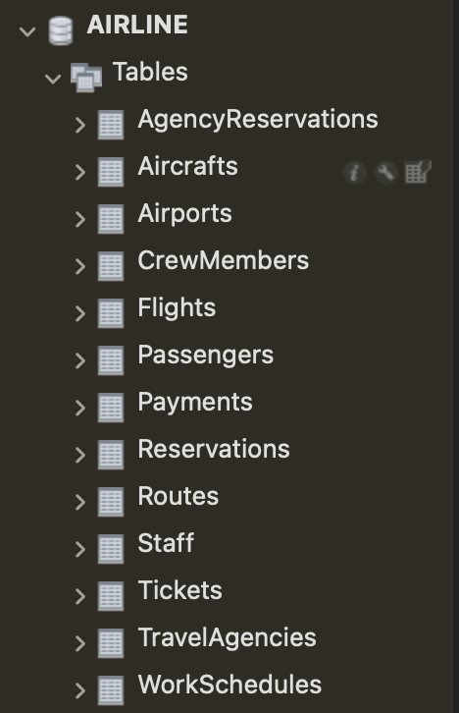
Airline Database

Slide 11
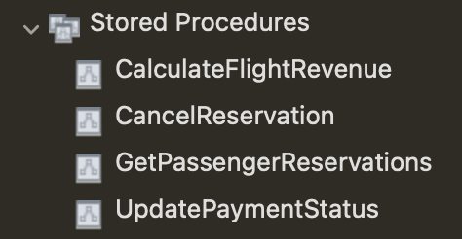
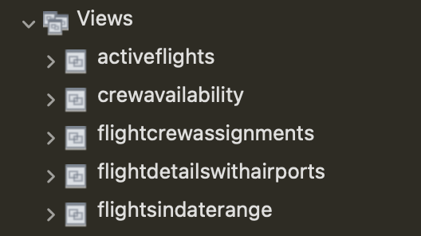
Stored Procedures
Views

Slide 12
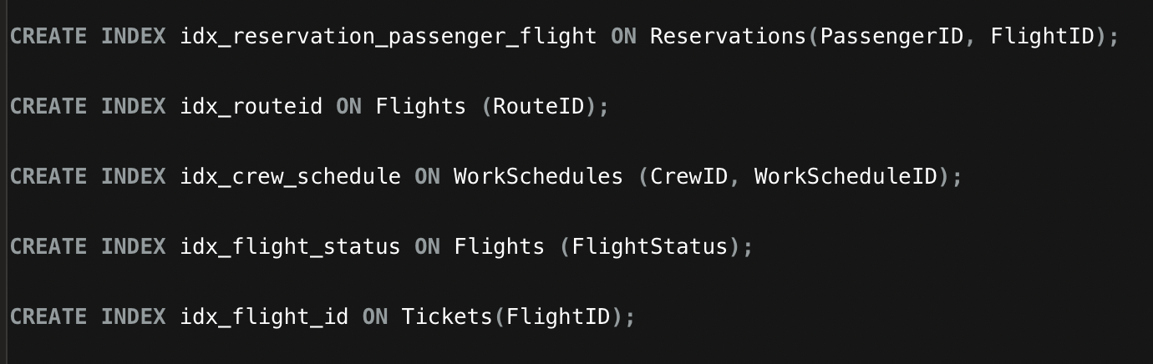
Indexes

Slide 13
Thank You

